Slide 1
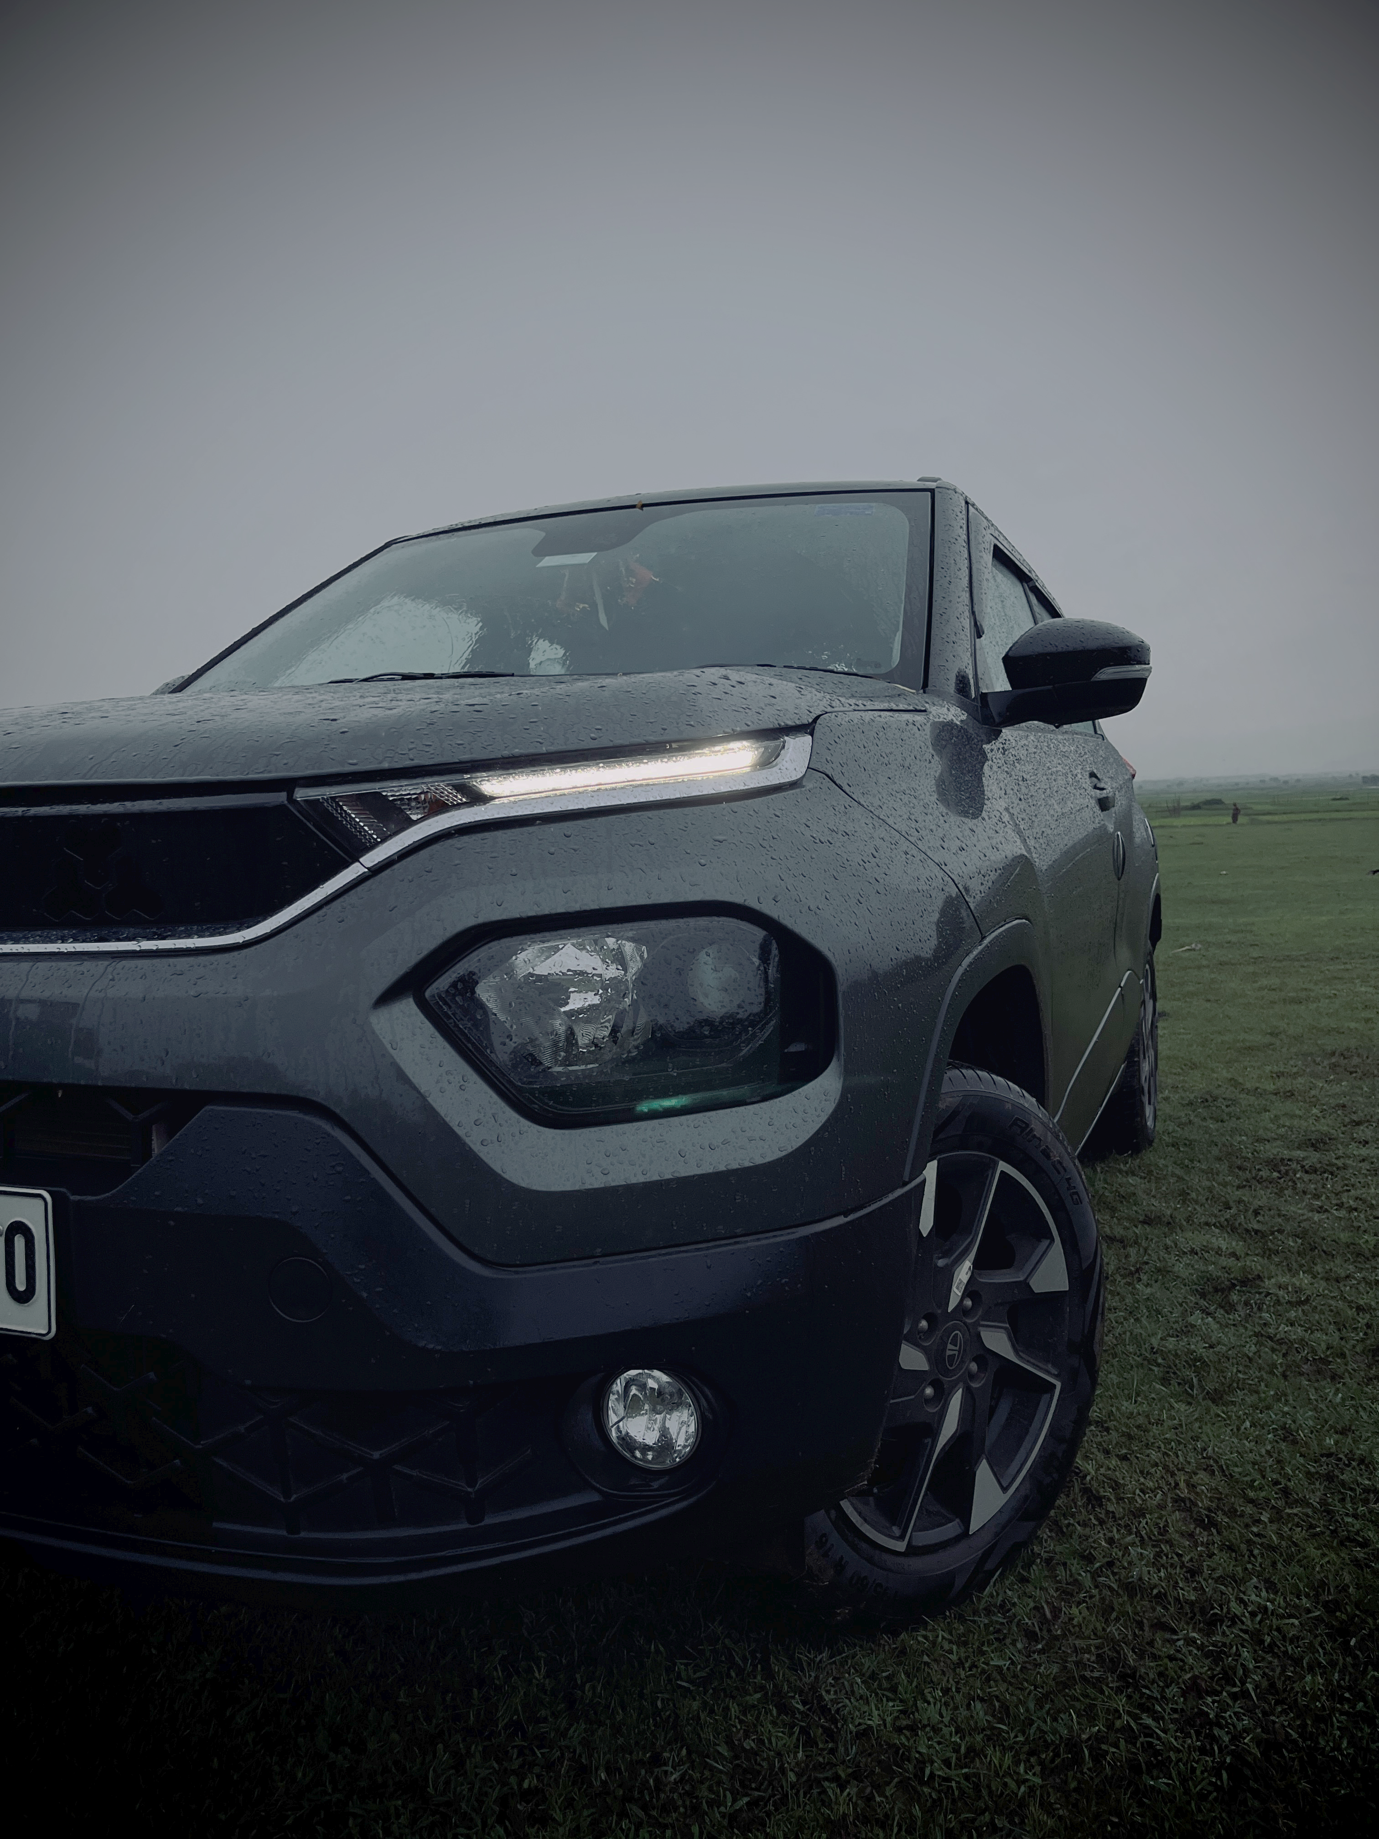
Tata Punch: System Flow using CAN, ECUs, and AUTOSAR
Use Case – Automatic Headlight Control & Speed Monitoring
GROUP 5
NAME | SLIDES
PRINCE | 1-4
USHA | 5-6
VIKAS | 7
JYOTISMAN | 8-9
DEEPAK | 10
SUMA | 11-12

Slide 2
Functional Overview
Vehicle: Tata Punch (Compact SUV)
Use Case: Automatic Headlight & Speed Warning
Key Features Involved:
- Ambient Light Sensor
- Speed Sensor
- Auto Headlights
- CAN Bus Communication
- Dashboard Alerts

Slide 3
ECUs Involved in Tata Punch System
Light Sensor ECU – Detects ambient light
Body Control Module – Controls headlight, horn, etc.
Speed Sensor ECU – Measures vehicle speed
Instrument Cluster ECU – Displays speed, alerts
Gateway ECU – Manages CAN communication

Slide 4
DIAGRAM OVERVIEW
[Driver Input - HMI ECU]
↓ (CAN Msg: ACC ON)
[Central Gateway ECU]
↓ (CAN)
[Radar ECU] → Distance → [CAN]
[Speed Sensor ECU] → Speed → [CAN]
↓
[Engine ECU] ←→ [Brake ECU]
↑
AUTOSAR (App + RTE + BSW)

Slide 5
CAN Bus Message Flow
CAN Messages:
- 0x200 → Light Level = Low
- 0x101 → Speed = 100 km/h
- 0x301 → Headlights ON
Flow:
Light Sensor ECU → BCM → Instrument Cluster ECU

Slide 6
AUTOSAR Stack in Tata Punch ECUs
AUTOSAR Layers:
- Application Layer (e.g. Headlight Logic)
- RTE (Connects App to BSW)
- BSW (CAN Driver, NVM, OS)
- MCAL (Sensor Interfaces)

Slide 7
End-to-End Flow in Tata Punch
Driver Turns ON Auto Light → Light Sensor ECU detects darkness
→ CAN Message → BCM → Headlights ON
→ Speed Sensor → Speed Sent via CAN
→ Dashboard Warning if Over Speed

Slide 8
FULL SYSTEM FLOW — Tata Punch Auto Lights & Speed Warning
+----------------------+ +----------------------+ +----------------------+
| Light Sensor ECU | | Speed Sensor ECU | | Instrument Cluster ECU|
| - Senses ambient light| | - Measures speed | | - Displays warnings |
+----------+-----------+ +----------+-----------+ +-----------+----------+
| | |
v v ^
CAN Msg: Light = Low CAN Msg: Speed = 100 km/h CAN Msg: Headlight ON
| | ^
v v |
+----------------------+ +----------------------+ +----------------------+
| Body Control Module |<------| Gateway ECU |----->| Application Logic |
| - Turns ON Headlights| +----------------------+ | - Headlight logic |
+----------------------+ +----------------------+

Slide 9
FLOW CHART
[Sensors (Radar, Camera)]
↓
[Sensor ECU (CAN Tx)] ─────────┐
↓
[ADAS ECU - AUTOSAR]
├─ Receives CAN
├─ Processes in SWC
├─ Uses RTE & BSW
↓
┌────────────┴────────────┐
↓ ↓
[Engine ECU - AUTOSAR] [Brake ECU - AUTOSAR]
↓ ↓
Adjusts throttle Applies brakes

Slide 10
Benefits of CAN + ECUs + AUTOSAR
- Scalable vehicle communication
- Real-time control of headlights and alerts
- Safe and reusable software via AUTOSAR
- Modular ECUs for easy upgrade

Slide 11
Key Takeaways
- Tata Punch uses distributed ECUs for each function
- CAN ensures real-time message passing
- AUTOSAR gives flexibility and standardization
Modern cars like Tata Punch rely on integrated architecture for safety, comfort, and automation.

Slide 12

THANK YOU

